Slide 1
Digital Portfolio
STUDENT NAME :- ASHWIN VINOD
REGISTER NO AND NMID:- 2422J1176 AND /8FD0F5CEECE6ECE954C4A13B3C6DF905
DEPARTMENT:- COMPUTER SCIENCE
COLLEGE: COLLEGE/UNIVERSITY:- JCT COLLEGE OF ARTS AND SCIENCE, BHARATHIYAR UNIVERSITY

Slide 2
SIMPLE PORTFOLIO WEBSITE

Slide 3


AGENDA
Problem Statement
Project Overview
End Users
Tools and Technologies
Portfolio design and Layout
Features and Functionality
Results and Screenshots
Conclusion
Github Link
3/21/2024 Annual Review

Slide 4

PROBLEM STATEMENT
In today’s digital era, organizations struggle with challenges such as data breaches, insecure communication systems, and cloud vulnerabilities. Despite rapid technological growth, many businesses lack professionals with the right mix of technical expertise and communication skills to safeguard their digital assets. As a BCA student passionate about cybersecurity and cloud computing, my goal is to bridge this gap by building strong technical knowledge, enhancing problem-solving skills, and contributing to secure, reliable, and innovative technology solutions.

Slide 5

PROJECT OVERVIEW
1. Personal Digital Portfolio Website
Built by Anamika TH using HTML and CSS.
Showcases About Me, Skills, Education, and Contact.
Fully responsive design suitable for desktop and mobile.
2. Skill Demonstration Projects (Future/Planned)
Basic Web Development Projects – Simple webpages to demonstrate my coding skills.
Cybersecurity Mini Projects – Lab exercises simulating data protection and encryption.
Cloud Computing Experiments – Small projects simulating cloud storage and retrieval.

Slide 6

WHO ARE THE END USERS?
1. Professors & College Faculty – to review skills and acade
2. Employers & Recruiters – to assess technical skills and projects
3. Intership Coordinators – for internship opportunities
4. Peers & Networking Contacts – for collaboration and connections

Slide 7

TOOLS AND TECHNIQUES
1. HTML & CSS – to structure and style the portfolio website.
2. Responsive Design Techniques – to make the website mobile-friendly.
3. Text Editors – e.g., VS Code or Notepad++ for coding.
4. Basic Web Development Knowledge – including layout, typography, and colors.
5. Project Planning &Organization – to structure sections like About, Skills, Education, and Projects.

Slide 8
POTFOLIO DESIGN AND LAYOUT
1. Clean, modern, and professional design with purple, white, and gold colors.
2. Responsive layout for desktop and mobile.
3. Sections: About Me, Skills, Education, Project Overview, Contact, Footer.
4. Easy navigation with anchor links.

Slide 9
FEATURES AND FUNCTIONALITY
1. Responsive Design – Works on desktop, tablet, and mobile.
2. Navigation Menu – Quick access to all sections.
3. Showcases Personal Info – About Me, Skills, Education, Projects.
4. Contact Section – Email, address, and phone for communication.
5. Professional Layout – Clean, modern, and visually appealing.

Slide 10
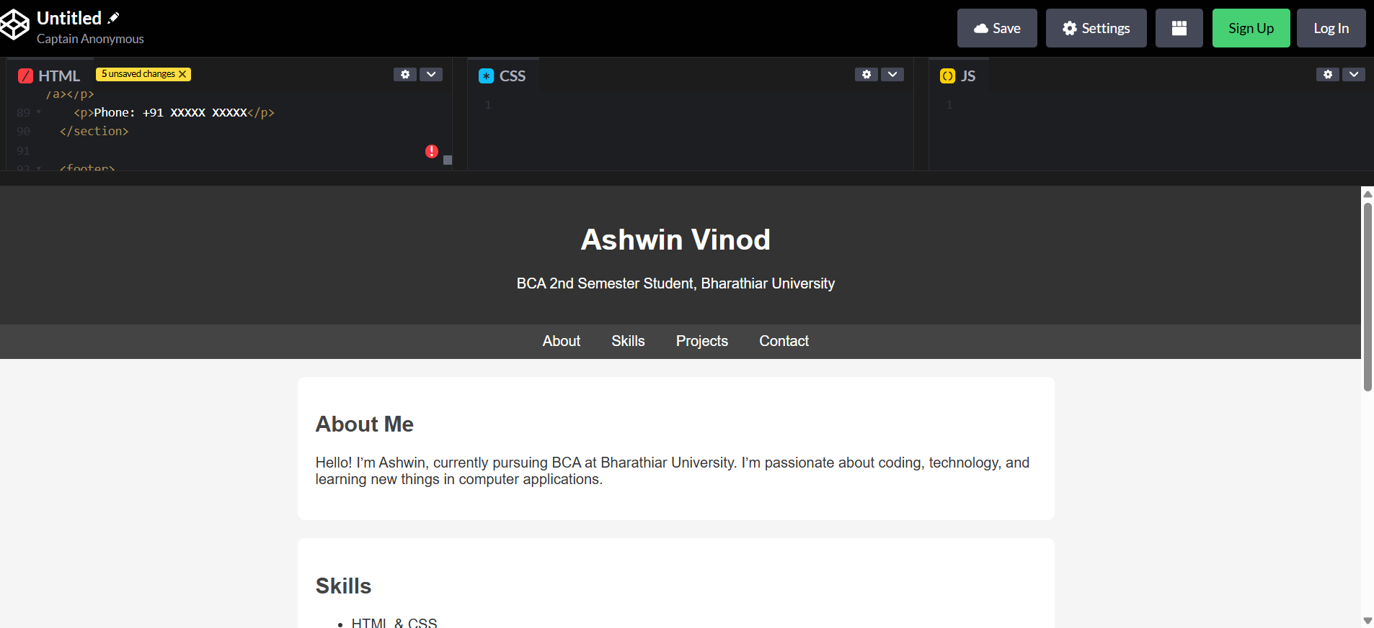

RESULTS AND SCREENSHOTS
3/21/2024 Annual Review

Slide 11
CONCLUSION
This portfolio showcases my skills, education, and projects, reflecting my passion for technology, cybersecurity, and cloud computing. It demonstrates my commitment to learning, professional growth, and building a strong foundation for future opportunities.

Slide 12
GITHUB LINK
https://github.com/ashveiii/index.html

